Slide 1
Robotics Project
Ryan Huitzil, Alejandro Suarez

Slide 2
The Start of the Sprints
Starting off was a bit slow since it was unfamiliar software and new challenges to overcome. Roles assigned were
Alejandro would do the block code/test runs and complete the flowchart since he’d have the information
Ryan would complete the SDD and any charts that were required within it

Slide 3
Challenges from Sprint 1
The robot had to be programmed when to stop and turn to complete lap around the course
Figuring out how to properly format details in the System Design Document
length of time
Speed
Direction

Slide 4
Sprint 2 (Accuracy)
This run was a big step up from the first one. It challenged both robot and block coder to figure out a good algorithm since the robot had to do the figure eight course for five times. It was a consistency of failure and had an outcome of a decent run

Slide 5
Challenges from sprint 2
Robot would constantly get thrown off course even with the same block code
Robot wasn’t fully charged
It would always end up hitting nearby tables
Algorithm
Consistency
Frustration

Slide 6
Sprint 3 (Agility)
Sprint was the most intermediate in terms of difficulty.
Had to go around pillars and knock over pins
The ramp jump was a problem if not put at the right speed

Slide 7
Sprint 3 difficulties
Starting aim
Angles for the robot to move
Speed
Making the jump
Knocking over all the pins

Slide 8
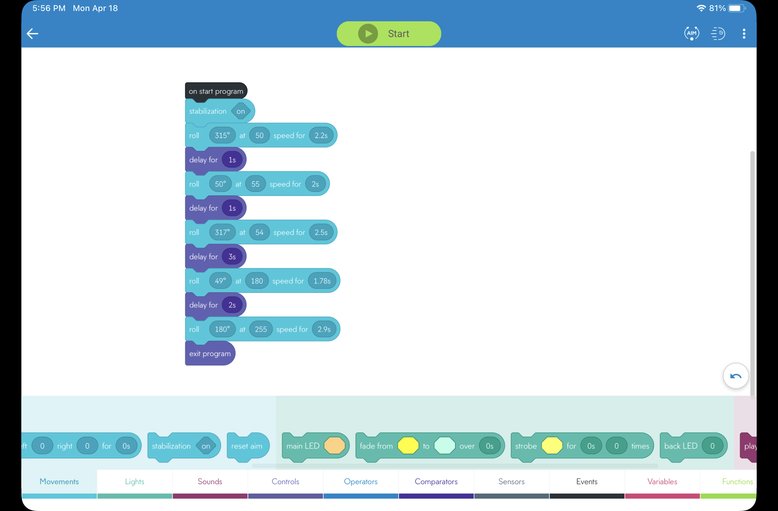
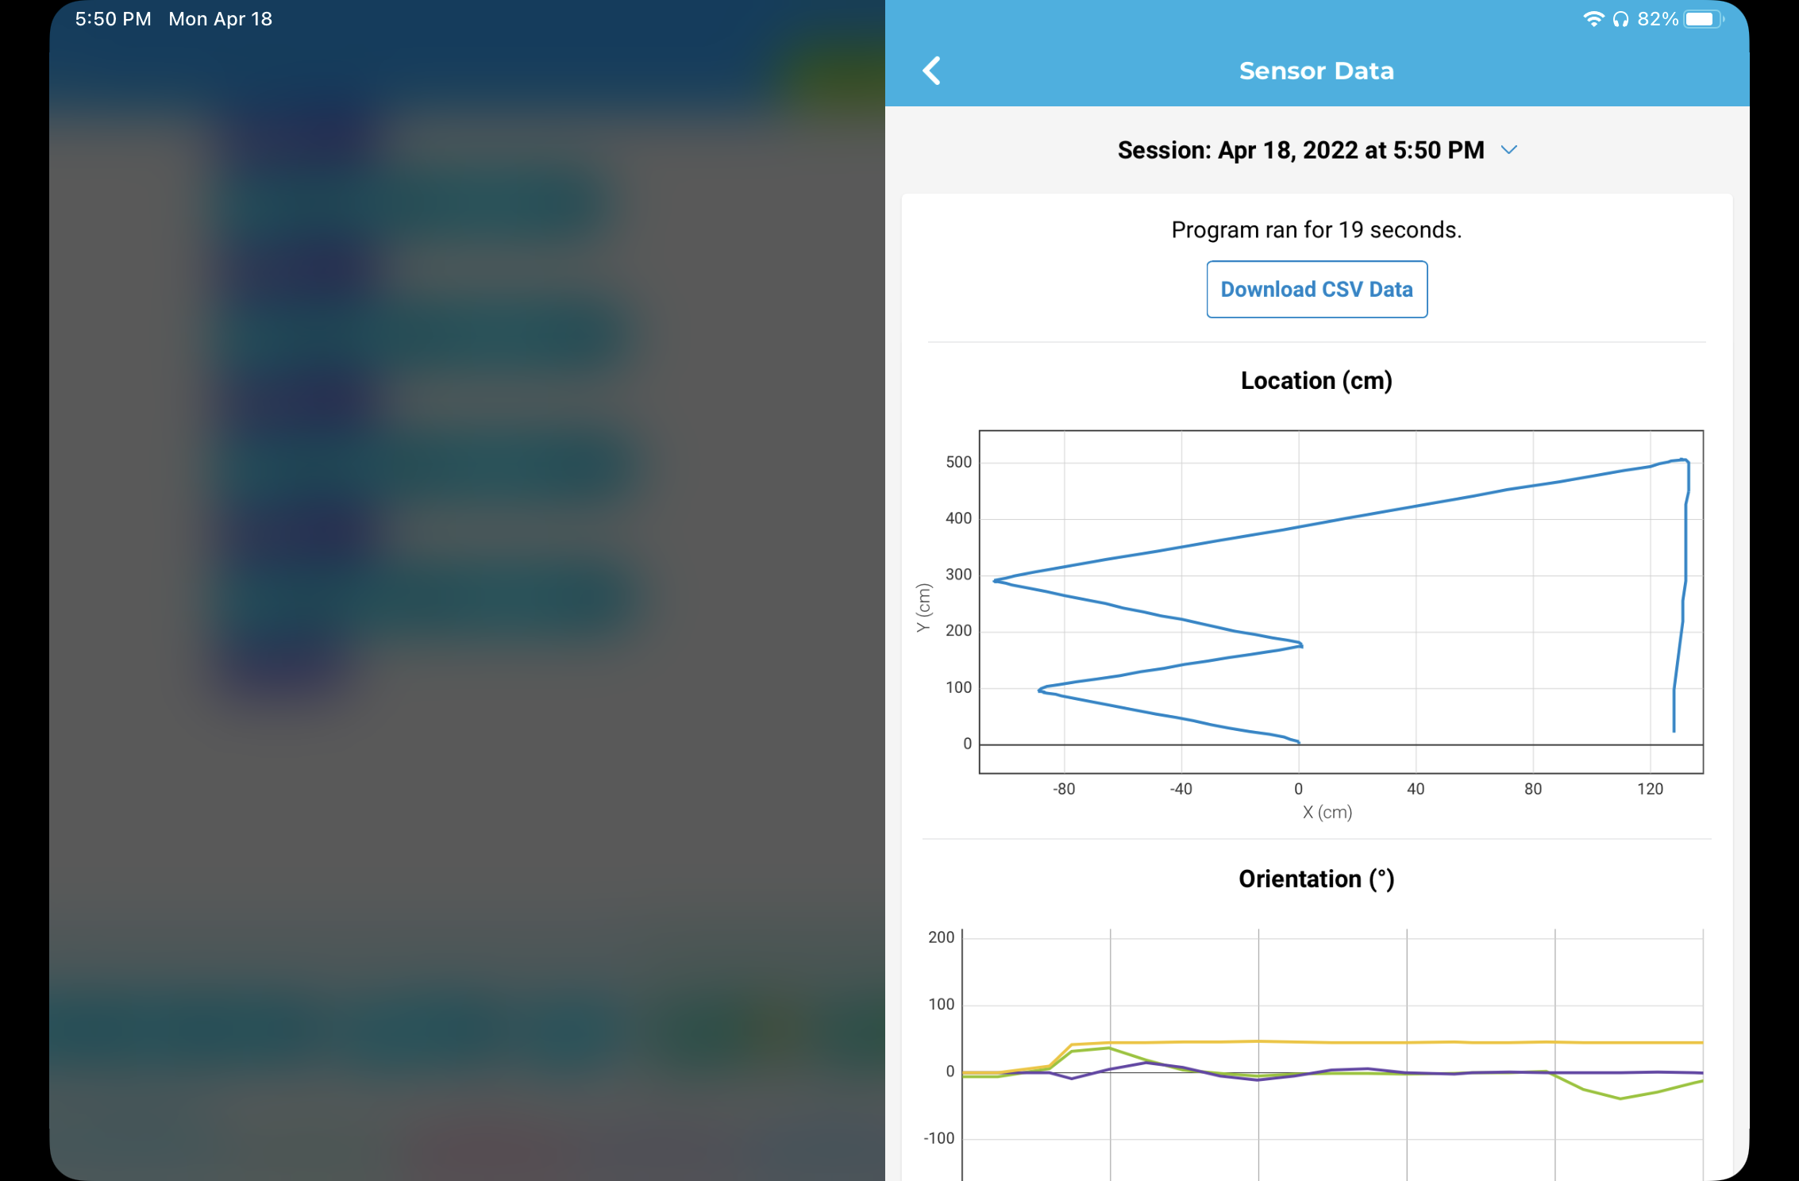
Code for sprint 3

Slide 9
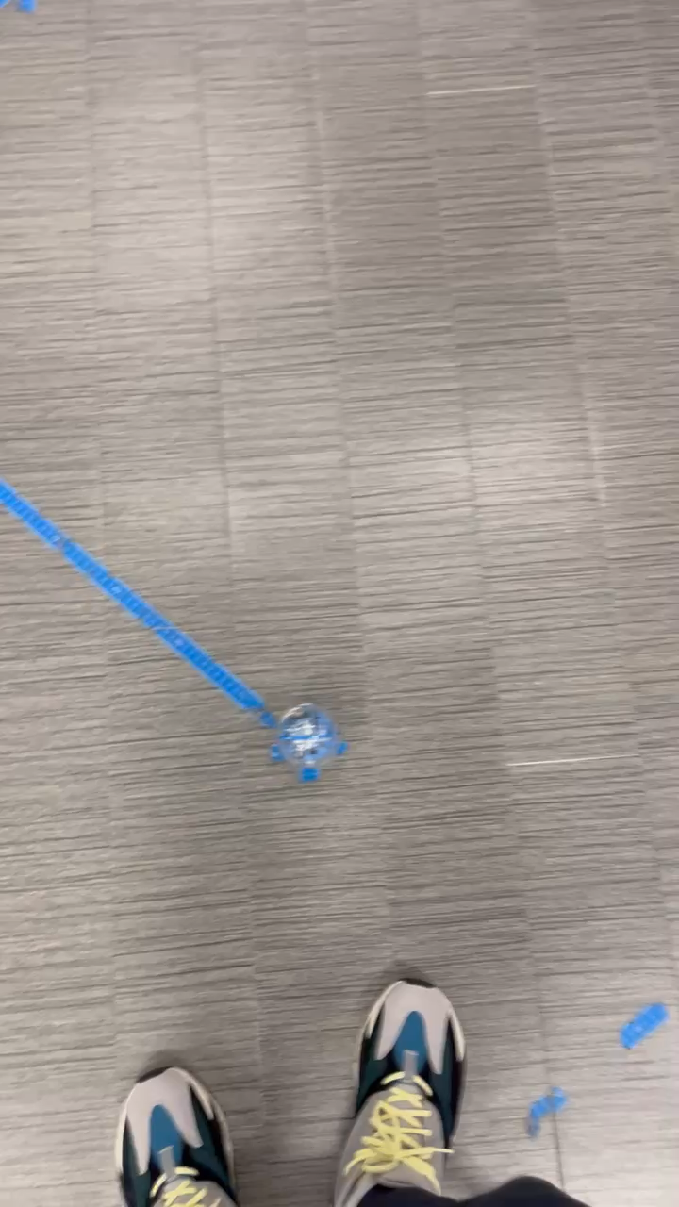
Video

Slide 10
What We Learned About S.E.
Failing test runs are important to improve
The importance of having an accurate code
Time management
Having a plan
Being able to adapt
Accepting failure
Learning teamwork

